Slide 1


Slide 2

Welcome and Purpose of This Conversation
Commitment to Openness and Care
  The school prioritises openness, care and partnership as foundations for its future.
Context and Transparency
  Leaders share the challenges small schools face to build trust and reduce uncertainty among families.
Reassurance and Inclusion
  The presentation aims to reassure families and invites questions to ensure everyone feels heard and valued.
Shared Future Journey
  The school emphasises care and shared responsibility in planning a positive future for children.

Slide 3
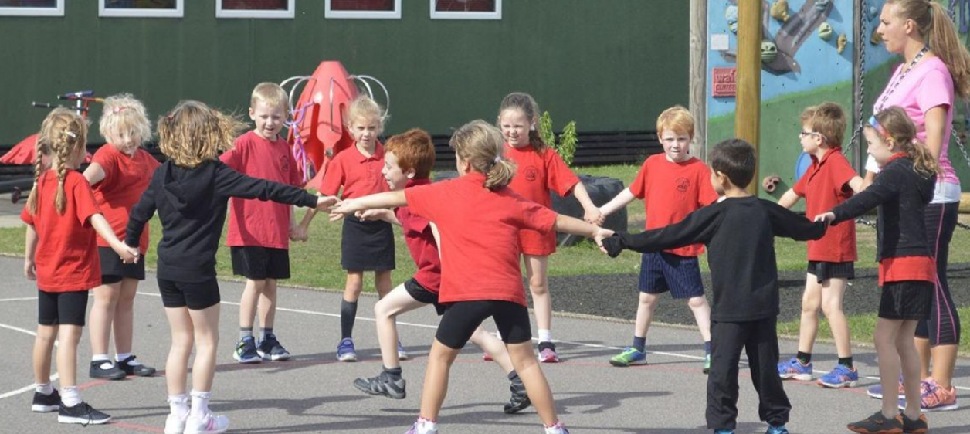
Why Schools Are Facing Change Nationally
Increasing Educational Complexity
Schools face growing demands in safeguarding, attendance, special needs, staffing, and financial accountability.
Falling Pupil Numbers
  Declining birth rates lead to fewer students and reduced funding, impacting school budgets and planning.
Benefits of Multi-Academy Trusts
  Joining trusts offers shared expertise and support, helping schools reduce vulnerability and improve stability.
Proactive Planning for Future
  Exploring changes reflects thoughtful planning to ensure schools thrive academically and socially long-term.

Slide 4
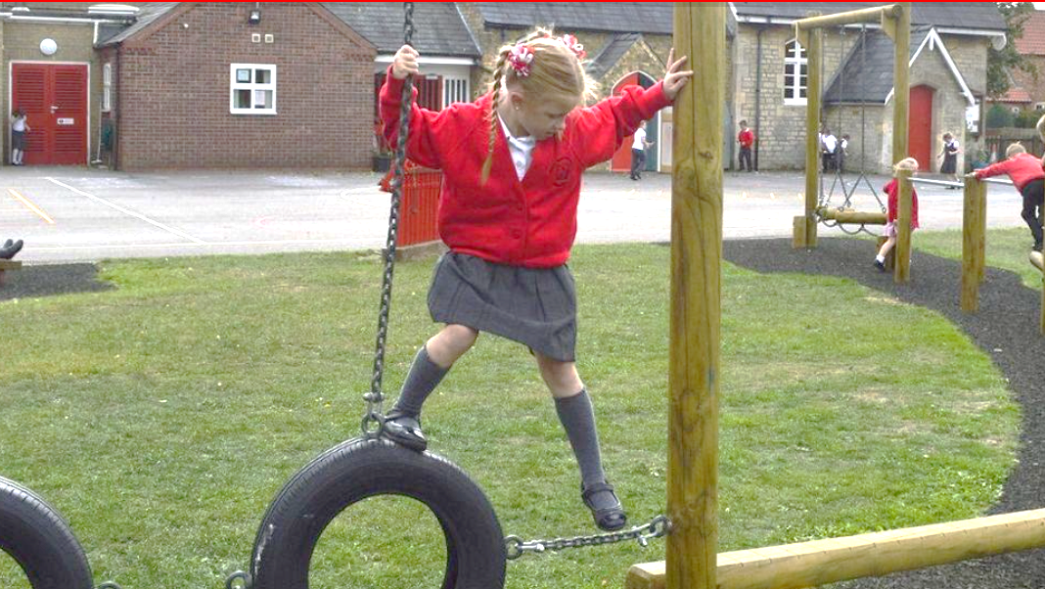
Our Responsibility as School Leaders and Governors
Long-Term Planning and Responsibility
  Leaders and governors focus on sustainable, long-term planning addressing financial and educational quality concerns.
Data-Driven Decision Making
  Governors review data, seek advice, and learn from others to make informed decisions in the best interest of the community.
Careful Consideration and Due Diligence
  Decisions involve careful exploration, working groups, and transparency to ensure alignment with school values and ethos.
Commitment to Community and Quality
  Actions are rooted in protecting and strengthening the school to benefit current and future pupils transparently.

Slide 5
Why a MAT & What It Means for Our Children

Slide 6

What Is a Multi-Academy Trust?
Definition and Purpose
  A Multi-Academy Trust is a group of schools collaborating while maintaining their individual identities and communities.
Shared Expertise and Support
  Trusts provide specialist advice and professional support in areas like finance, safeguarding, and curriculum development.
Community and Identity Preservation
  Joining a trust does not change a school’s local character; familiar staff and caring environments remain intact.
Collaboration Over Competition
  Trusts focus on helping schools be their best selves through collaboration, not uniformity or unnecessary change.

Slide 7
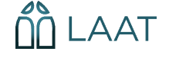
Why We Are Exploring LAAT (Lincoln Anglican academy trust) Specifically
Alignment with School Values
  LAAT shares our school’s Christian foundation, focusing on dignity, care, and equity for every child.
Understanding Rural Schools
  LAAT recognises unique challenges and strengths of small rural schools and values community identity.
Collaborative Trust Model
  LAAT promotes partnership and collaboration among schools while respecting individuality and local voice.
Capacity and Stability
  LAAT provides strong financial resilience, experienced support teams, and proven school improvement expertise.

Slide 8
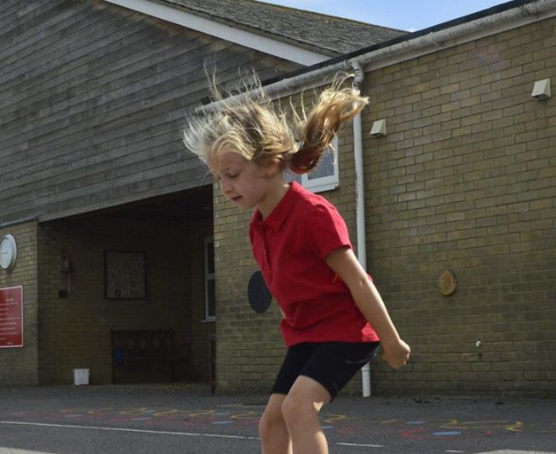
What This Could Mean for Your Child
Enhanced Learning Opportunities
  Joining a trust opens doors to wider experiences and shared expertise beyond standalone schools.
Specialist Support Access
  Increased access to specialist support ensures children receive timely help tailored to their needs.
Focus on Equity
  Resources are directed where most needed to remove barriers and promote digital and enrichment access.
Long-term Stability
  Strengthened foundations allow focus on learning and wellbeing, ensuring safe and supportive environment.

Slide 9
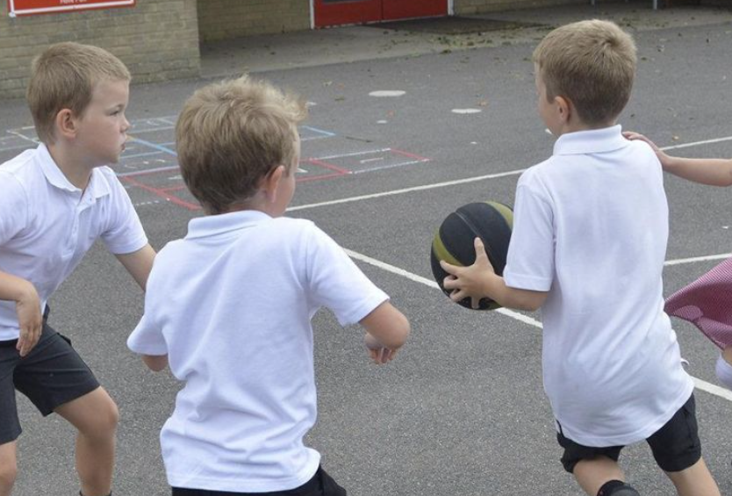
Opportunities and Enrichment Through Collaboration
Shared Enrichment Opportunities
  Collaboration within the trust provides pupils with access to shared events, specialist teaching, and trust-wide initiatives in music, sport, and leadership.
Enhanced Teaching Quality
  Teachers collaborate to moderate work, share effective strategies, and deepen curriculum development, enhancing classroom practice and student learning.
Digital Inclusion Strategy
  LAAT’s digital strategy improves technology access for vulnerable pupils,
  supporting learning at school and home and closing the digital divide.
Balanced Enrichment Approach
  Enrichment is meaningful and well-supported, complementing a caring
  approach without overloading children, blending security with wider
  opportunities.

Slide 10
Reassurance and Next Steps

Slide 11

What Will Stay the Same
Continuity in Education
  Pupils remain central, taught by familiar staff in the same trusted school buildings and community.
Core Christian Values
  Christian vision and values like Kindness, Learning, and Trust continue guiding school life and relationships.
Preserving Traditions
  Daily routines and traditions remain cherished, strengthening foundations rather than replacing them.
Focus on Stability
  Priority remains on children feeling safe, known, and supported, ensuring continuity alongside growth.

Slide 12

What About Staff and Stability?
Staff Stability and Wellbeing
  Stable staff create trusted relationships, supporting children’s wellbeing and consistent school life.
Support Through Trust Membership
  Being part of a trust improves staff support with professional development and wellbeing resources.
Protected Employment Conditions
  National pay and clear protections ensure staff security and minimise disruption during transitions.
Benefits for Families and Children
  Well-supported staff provide continuity and confidence, helping every child thrive in learning.

Slide 13
Listening to Families and Community Voice
Valuing Community Input
Listening to families and community voices is essential for inclusive decision-making and building trust.
Transparency and Communication
Ongoing transparency, respect, and honest communication are promised throughout the engagement process.
Collaborative Partnership
Working together with families ensures decisions are grounded in lived experiences and mutual understanding.

Slide 14
Moving Forward Together with Care
Guiding Principle of Care
  Care is central for children, families, staff, and the school's future, ensuring stability and shared values.
Engagement and Reflection
  Ongoing dialogue and reflection are vital as the school explores joining LAAT and moving forward together.
Support Through Change
  Families are encouraged to discuss concerns, fostering reassurance through thoughtful, values-led change.
Partnership for a Hopeful Future
  By working with openness and kindness, the school ensures a safe and inspiring place for children.

Slide 15

Thank you for listening.
Do you have any reflections or Questions?

